Slide 1
Chapter 3-1 Random Number Generator
Dr. Faiz Al Shrouf

Slide 2
Congruence Modulo-m method
In this method the following recursive equation be used:
X_{i+1}=a*X_{i} (mod m)
Where
Xi is previous value or initial (seed) if is X_{0,}
a: is multiplier.
m: is modulus.
X_{i+1} have a range between 0 and less than m. To modify X_{i+1} to R_{i+1}, which is in the range 0 to less than 1 then R= X_{i+1} /m. The following flowchart represents the steps of generation RN using this method

Slide 3
Start
Select X₀ (initial value), m (modulus) and a (multiplier). Let i=0.
X_{i+1}=a*X_{i} (mod m)
R= X_{i+1} /m
i=i+1
Yes
R represents a RN
More RN
End

Slide 4
Example:
Calculate first five random numbers using Congruence Modulo-m method, with X₀=3, a=5 and m=32.
Answer:
X₁=5*3 (mod 32)=15, R=0.46875
X₂=5*15 (mod 32)=11, R=0.34375
X₃=5*11 (mod 32)=23, R=0.71875
X₄=5*23 (mod 32)=19, R=0.59375
X₅=5*19 (mod 32)=31, R=0.96875

Slide 5
Rules for choosing m, X₀, and a
The modulus (m) is chosen as large as possible to maximize period of RN’s, m=2^{b}-1, where b (in bits) is the word length of the computer.
The multiplier (a) be chosen to minimize correlation between RN’s and keep the period large, a=2^{b/2}±3.

Slide 6
The seed (X₀) is the initial value should be positive, odd, integer, and X₀ <m.
Period=m/4, when m, X₀, and a are chosen in this way.

Slide 7
With a and m are constants different sequences of RN’s can generated by choosing different values of seed (X₀). These different sequences of RN’s called stream.
Different streams are generate for different values of m and a.

Slide 8
X₀
Stream_1
Seq₁
a₁
m₁
X_{n}
Seq_{n}
X₀
Seq₁
a₂
m₂
Stream_2
X_{n}
Seq_{n}
X₀
Seq₁
Stream_K
a_{K}
m_{K}
X_{n}
Seq_{n}

Slide 9
Problem:
The Congruence Modulo-m generator is to be implemented on a computer having a 12-bits word length. Determine an appropriate set value for m, X₀, and a, then calculate the first five RN’s and the period.

Slide 10
Answer:
m=2¹²-1=4095
a=2⁶±3=67 or 61, take a=67
select X₀ =129
X_{i+1}=a*X_{i} (mod m)
X₁=67*129 (mod 4095)=453, then R1=0.110622711
X₂=67*453 (mod 4095)=1686, then R2=0.411721612
X₃=67*1686 (mod 4095)=2397, then R3=0.585347985
X₄=67*453 (mod 4095)=894, then R4=0.218315018
Period=4095/4=1023

Slide 11
Testing of RN generator
The RN generator was evaluated by such measures as:
Speed of generation
Memory requirements
Uniformity of generation
Minimum correlation of number generation.
The first two (speed and memory) are not our concern because recent times the available computers are so fast and have large memory.
For the last two measurements we use some statistical methods as follows:

Slide 12
See Congruence Modulo Excel Example

Slide 13
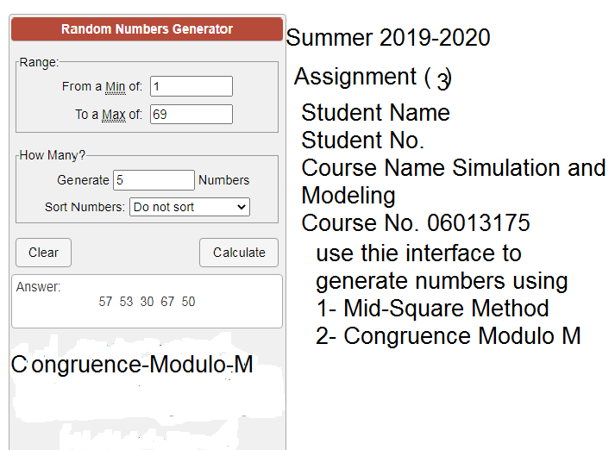
Assignment 3

